Slide 1

Factory Method Design Pattern
By Xesh & Nicole
Monday 14 November

Slide 2
What are design patterns?
A design pattern provides a general reusable solution for the common problems that occur in software design. The pattern typically shows relationships and interactions between classes or objects.
Design patterns are programming language independent strategies for solving a common problem. That means a design pattern represents an idea and a concept, not a particular implementation. By using design patterns, you can make your code more flexible, reusable, and maintainable.
Notes:
Nicole

Slide 3
Design patterns in Java
Creational | Structural | Behavioral
These design patterns are all about class instantiation or object creation | These design patterns are about organizing different classes and objects to form larger structures and provide new functionality. | Behavioral patterns are about identifying common communication patterns between objects and realizing these patterns.
Creational design patterns are the Factory Method, Abstract Factory, Builder, Singleton, Object Pool, and Prototype. | Structural design patterns are Adapter, Bridge, Composite, Decorator, Facade, Flyweight, Private Class Data, and Proxy. | Behavioral patterns are Chain of responsibility, Command, Interpreter, Iterator, Mediator, Memento, Null Object, Observer, State, Strategy, Template method, Visitor
Notes:
Nicole

Slide 4
What is the factory method pattern?
Factory Method is a creational design pattern that define an interface for creating objects in a superclass, but allows subclasses to alter the type of objects that will be created.
Notes:
Xesh

Slide 5
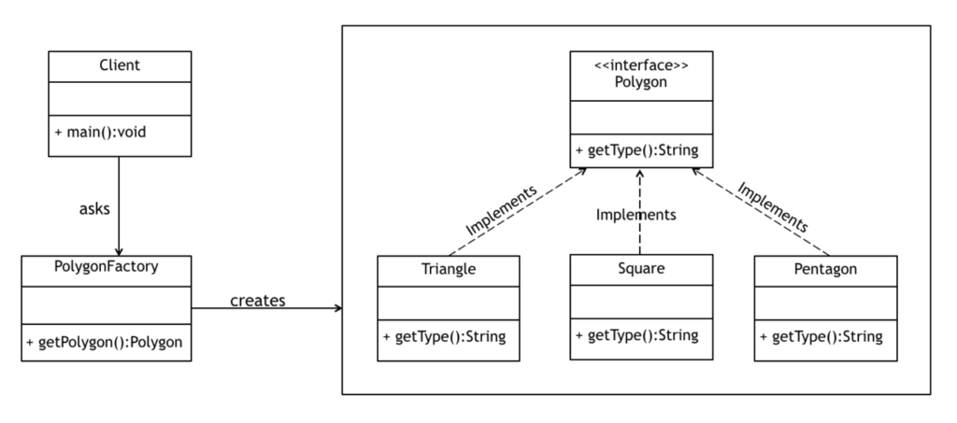
What is the factory method pattern?
Notes:
Nicole & Xesh

Slide 6
When should we use this as developers?
When the implementation of an interface or an abstract class is expected to change frequently;
When the current implementation cannot comfortably accommodate new change;
When the initialization process is relatively simple, and the constructor only requires a handful of parameters.
Notes:
Nicole

Slide 7
Pros & cons
Pros | Cons
Single Responsibility Principle. You can move the product creation code into one place in the program, making the code easier to support. Open/Closed Principle. You can introduce new types of products into the program without breaking existing client code. | The code may become more complicated since you need to introduce a lot of new subclasses to implement the pattern. The best case scenario is when you’re introducing the pattern into an existing hierarchy of creator classes.
Notes:
Nicole & Xesh

